Slide 1

Identification of Suitable Sites for Groundwater Recharge using Rainwater Harvesting
Submitted by
Ananya Srivastava- IIRS2021021011302
Samhitha Bollepally- IIRS2021021510996
Lavinia Tamang- IIRS2021020911508

Slide 2
INTRODUCTION
India’s utilizable water resource is 1122 BCM (billion cubic meters), out of which surface water and renewable groundwater account for 690 BCM and 432 BCM, respectively.
Recently, the water demands have increased due to population growth while the per capita water availability has decreased due to the changing climate.
This has led to the revival and modernization of rainwater harvesting techniques.
Major benefits of rainwater harvesting include efficient use of available natural resources, augmentation of existing supply capacity, reduced contaminant loads into water bodies, reduced load on the sewer network, reduced soil erosion, reduced flood and drought risks, and environmental protection.
This research attempts to integrate one of the best methods of identifying rainwater harvesting i.e., AHP to derive weights and SCS-CN (or NRCS-CN) method to estimate the runoff potential in the region.

Slide 3
Research Questions
1. What are the suitable sites for groundwater recharge in the Bhilwara district of Rajasthan using rainwater harvesting?
2. What is the estimated area of groundwater recharge from these potential sites?
Research Objectives
1. To identify suitable sites for groundwater recharge using rainwater harvesting and estimate the area of groundwater recharge.
2. To find sites for rainwater harvesting structures.
3. To estimate the area with the potential for groundwater recharge from these sites.

Slide 4
LITERATURE REVIEW
Different studies efficiently used Analytical Hierarchy Process (AHP) ( Ammar et al., 2016; Krois & Schulte, 2014; Jothiprakash & Sathe, 2009) for the identification and optimization of the potential water harvesting sites. In some recent studies, AHP is integrated with Fuzzy Logic to standardize the factors and derive weights used as a total score for land suitability (Alwan et al., 2020; Al-Abadi et al., 2017).
The papers (Abdulla Umar Naseef & Thomas, 2016; Mahmoud & Alazba, 2015) focused on factors such as rainfall, slope, potential runoff coefficient (PRC), land cover/use, and soil texture. Most of the studies initially considered filled sinks of the digital elevation model (Alwan et al., 2020; Karani et al., 2019; Tiwari et al., 2018) and (Tiwari et al., 2018) made proper use of depression sites as natural structures for rainwater harvesting.
Various researches suggested the runoff estimation through the water balance approach (Jasrotia et al., 2009), Soil Conservation Service - Curve Number (SCS-CN) method (Tiwari et al., 2018; Krois & Schulte, 2014; Kadam et al., 2012; Ramakrishnan et al., 2009) Artificial Neural Network (ANN) based model (Sarkar & Kumar, 2012). The most widely used for the estimation of runoff is the SCS-CN method.

Slide 5
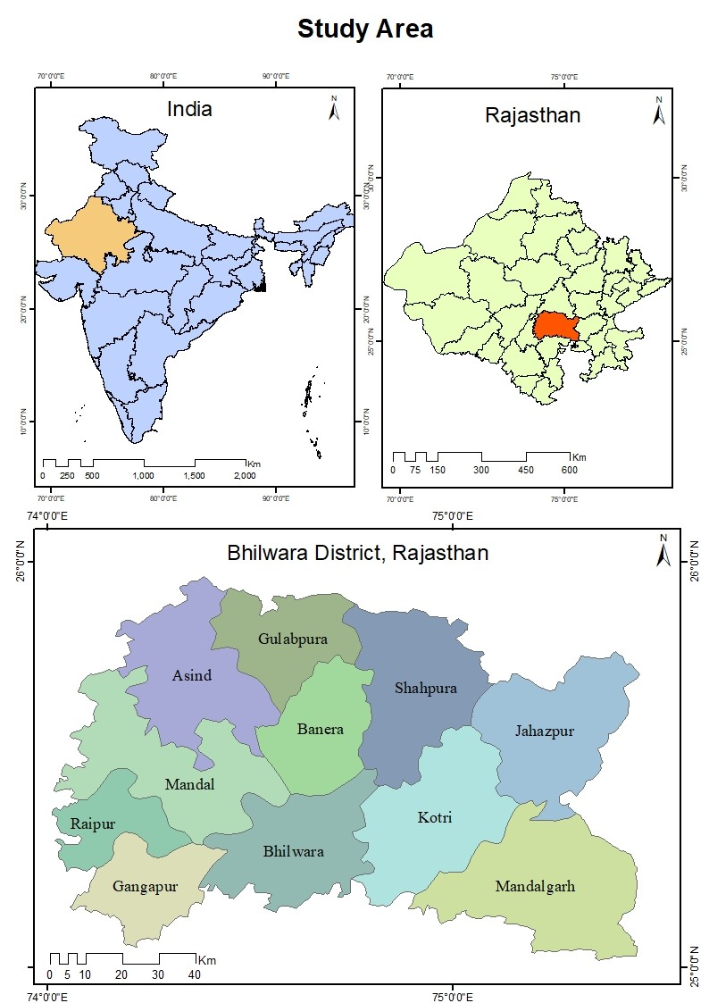
Bhilwara district falls in the Banas (9157.2 sq. km), Chambal (1164.9 sq. km) & Luni basins (133.0 sq. km).
The Major River of the district is Banas, which flows northeast to an easterly direction. All these are ephemeral.
Soil is clayey loam found in the hilly areas in the central parts of the district while loam is found in the entire district. The groundwater level of all the 11 blocks of the district is ‘Over Exploited’.
The spatial distribution of Schist is the most predominant covering 47.5% of the district whereas gneisses are next in the sequence with about 43% spatial coverage.

Slide 6
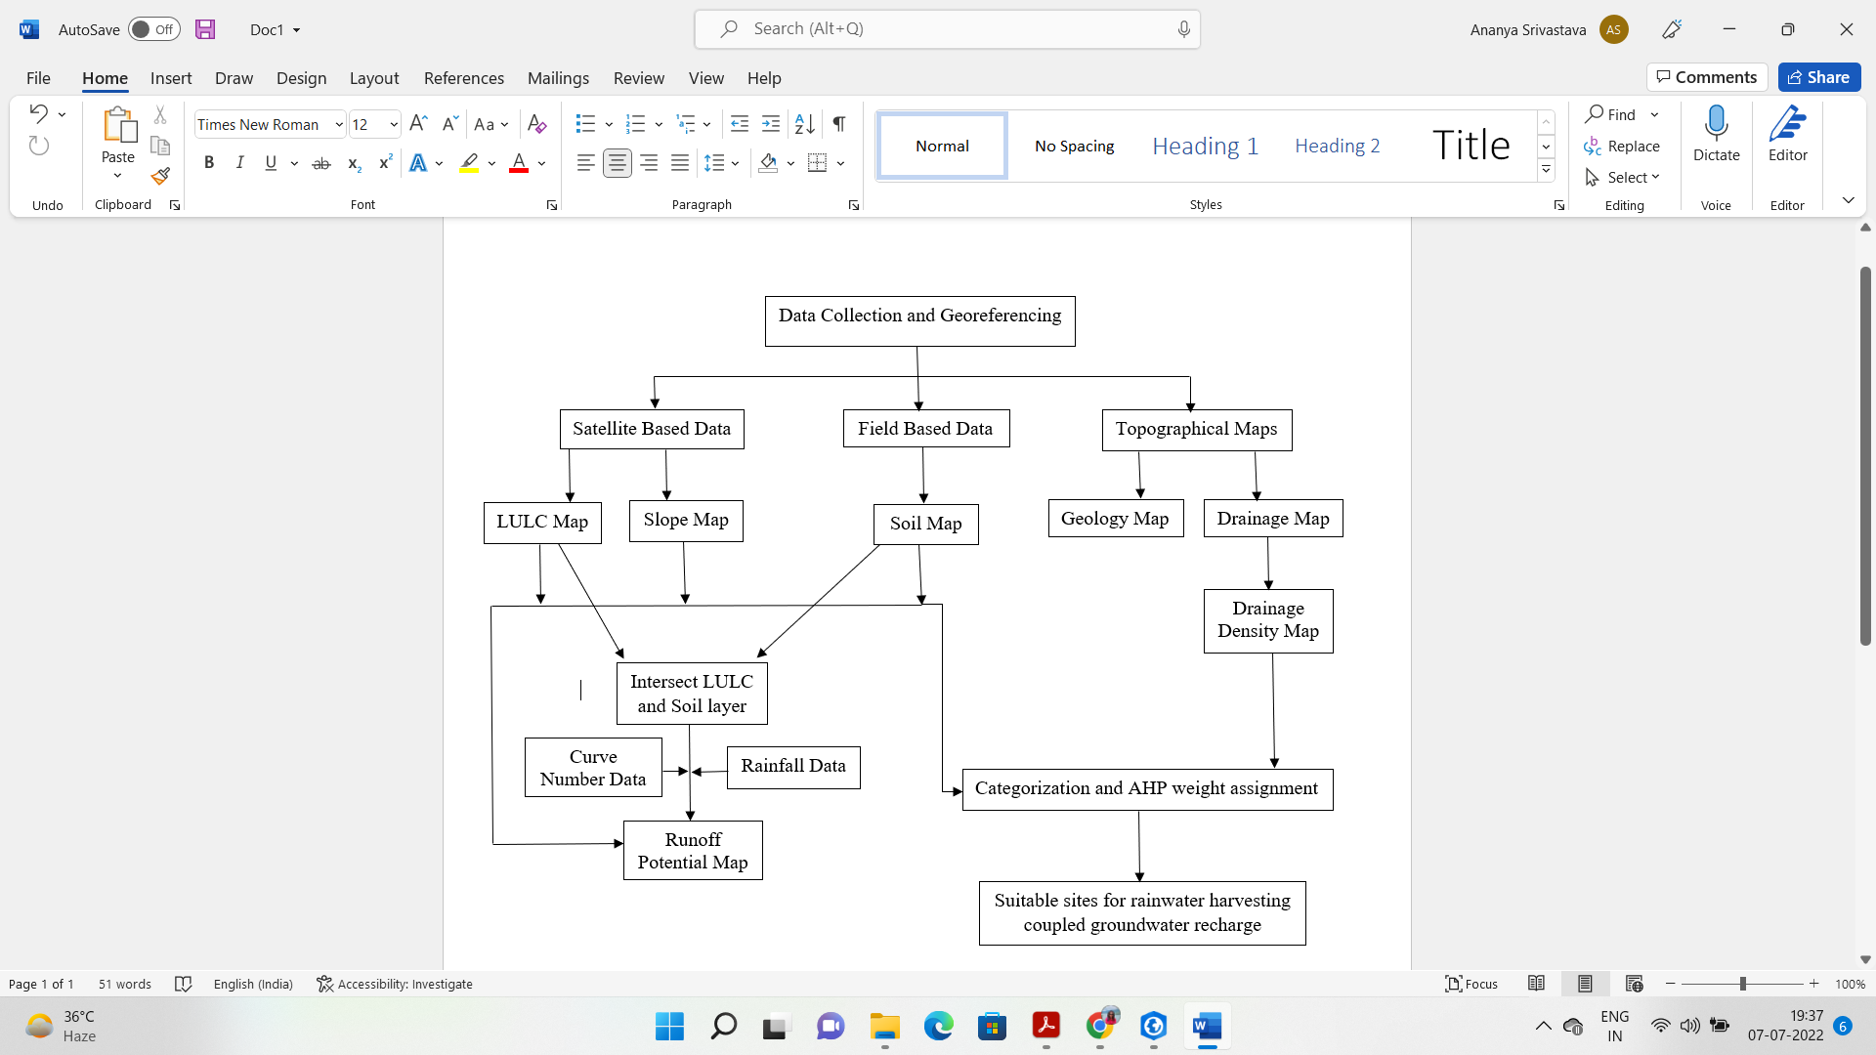
METHODOLOGY

Slide 7
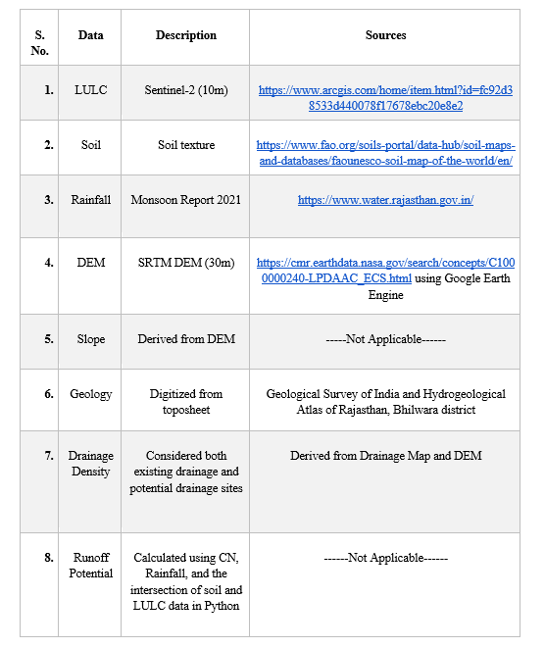

Slide 8
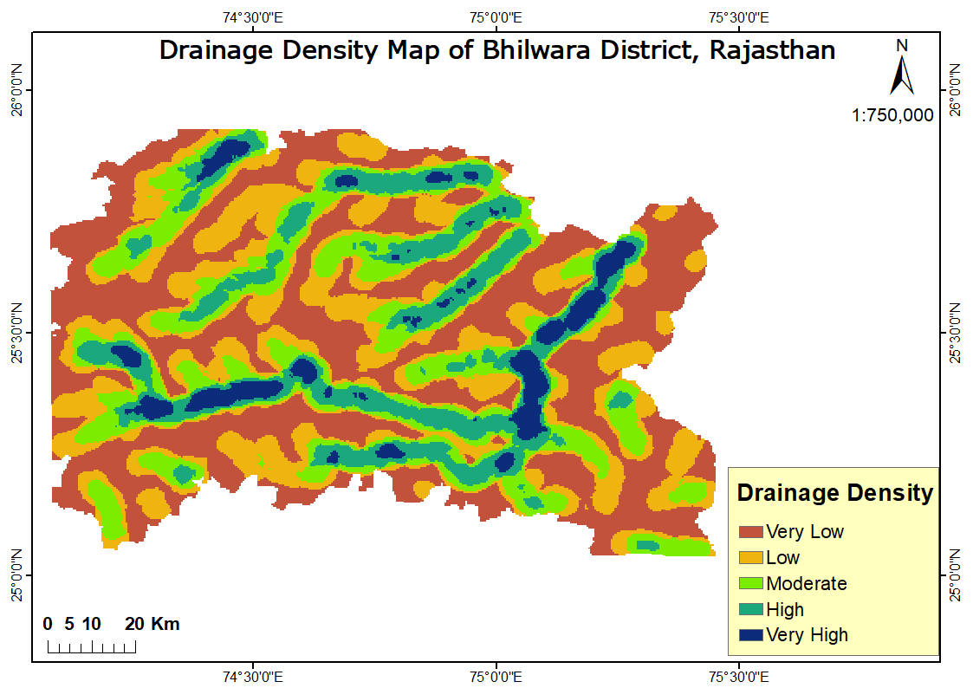

Slide 9
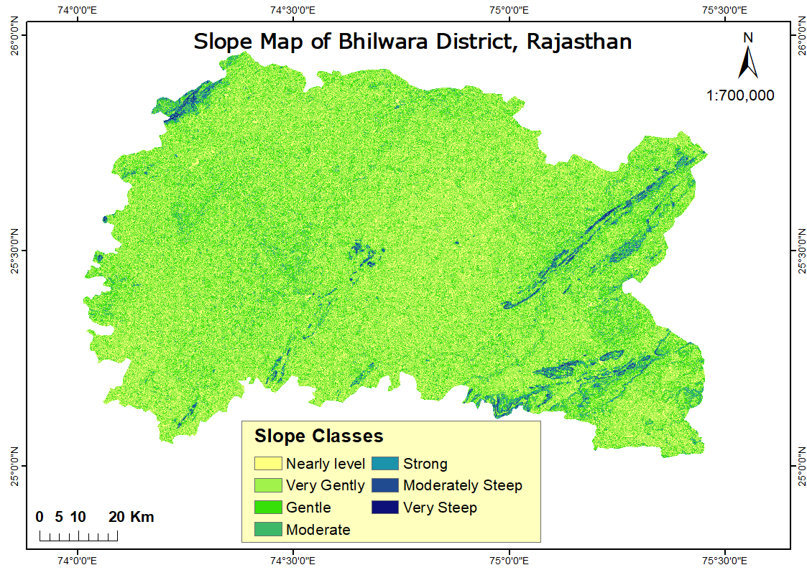

Slide 10
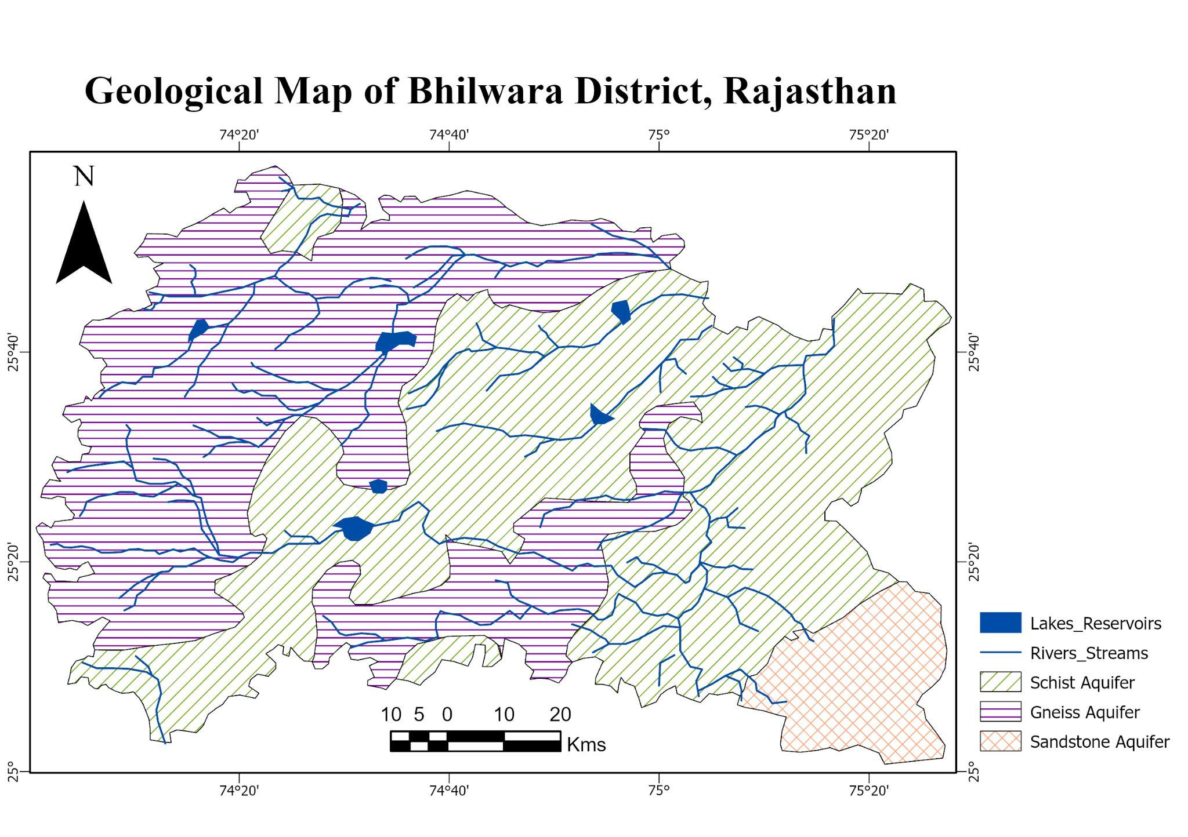

Slide 11
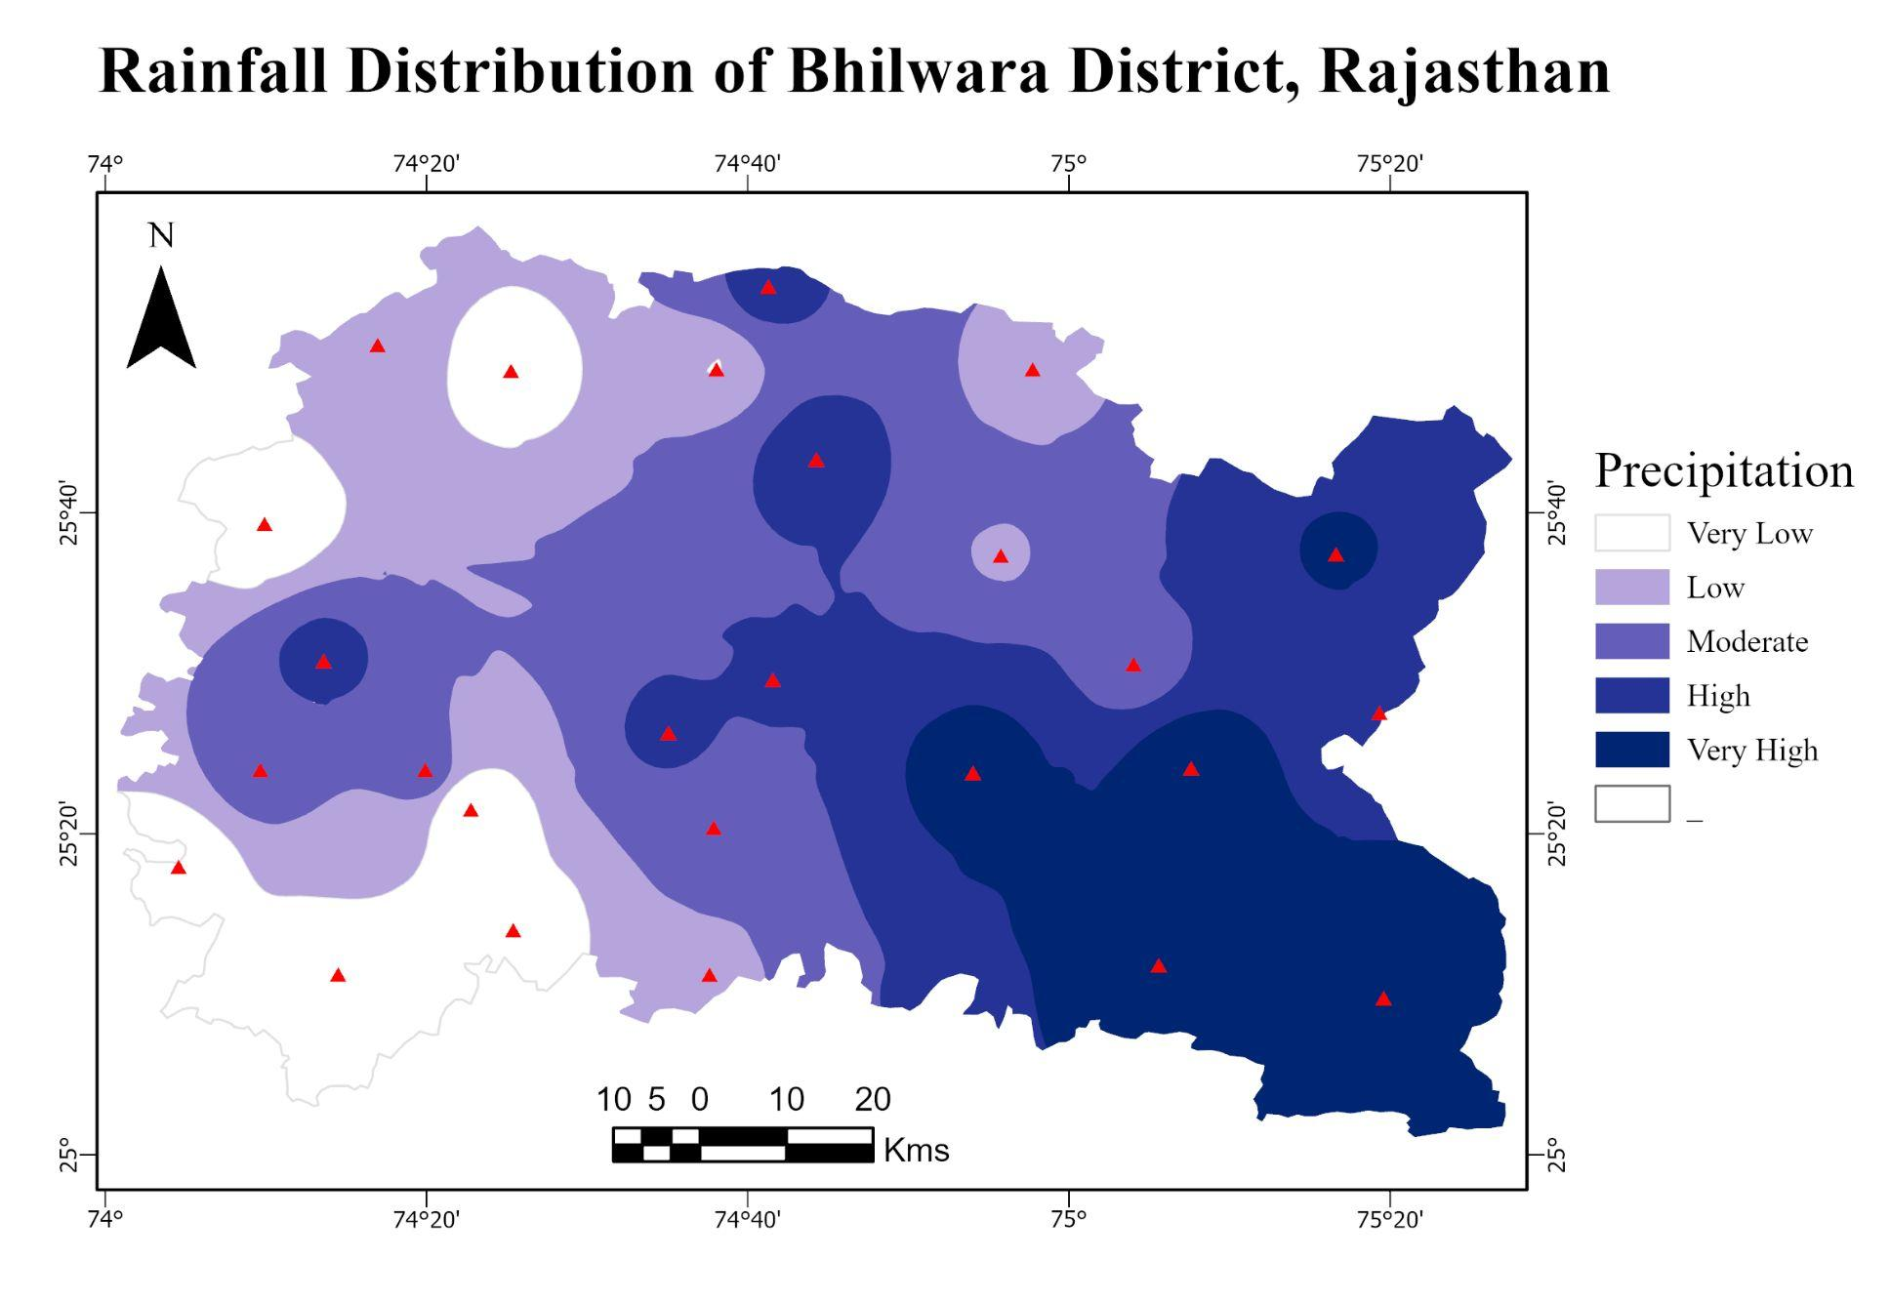

Slide 12
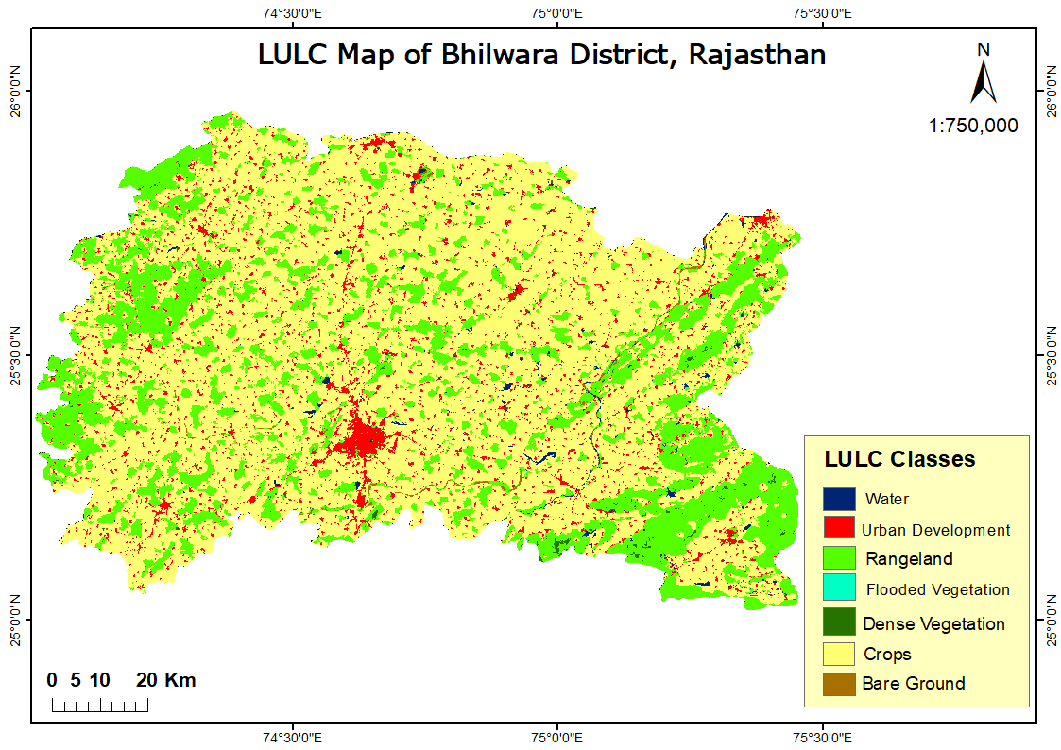

Slide 13
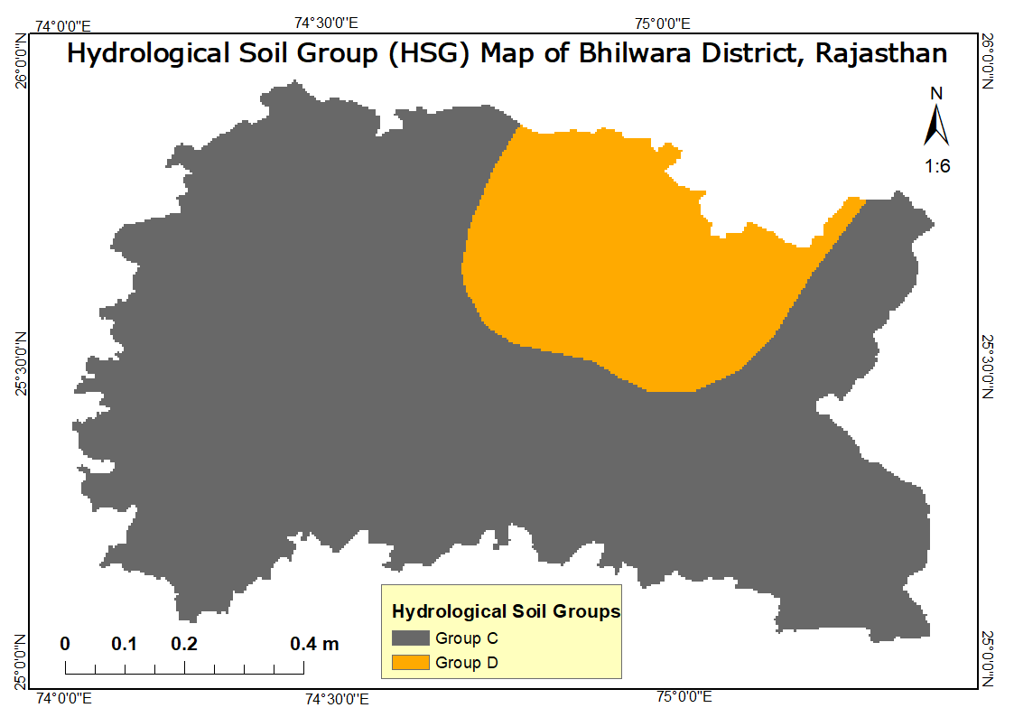

Slide 14
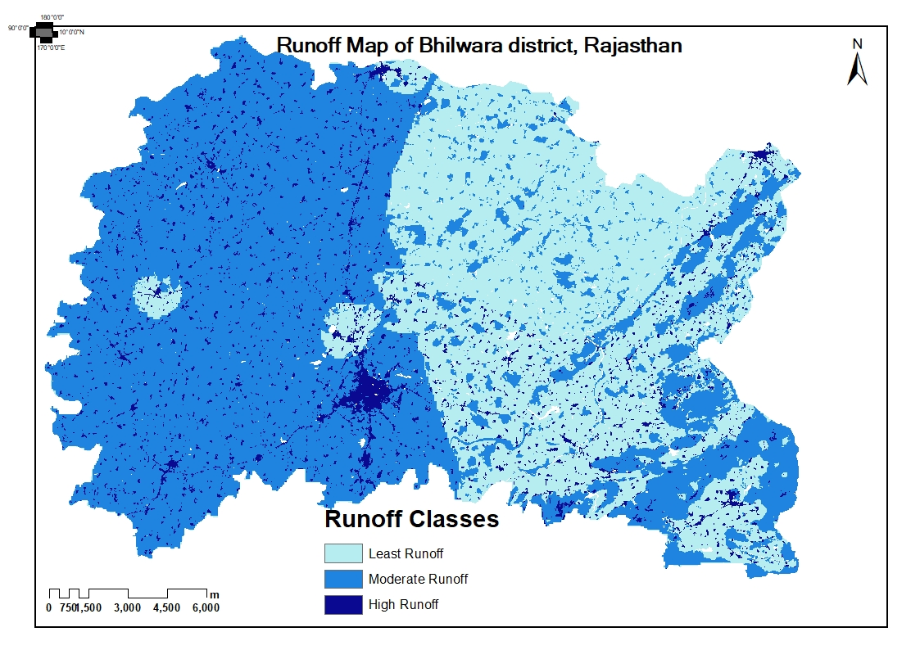

Slide 15
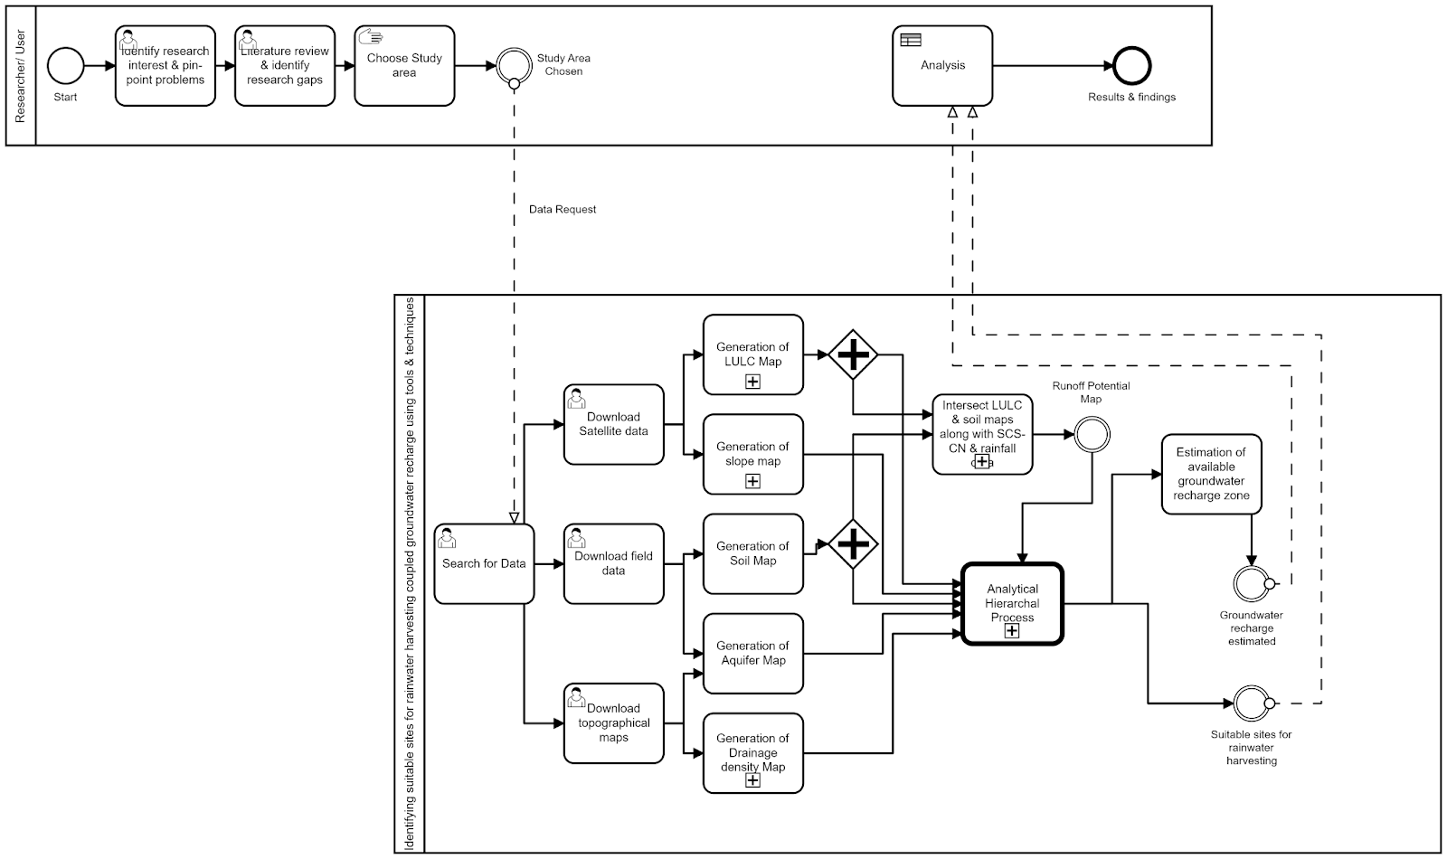
BPMN Diagram

Slide 16
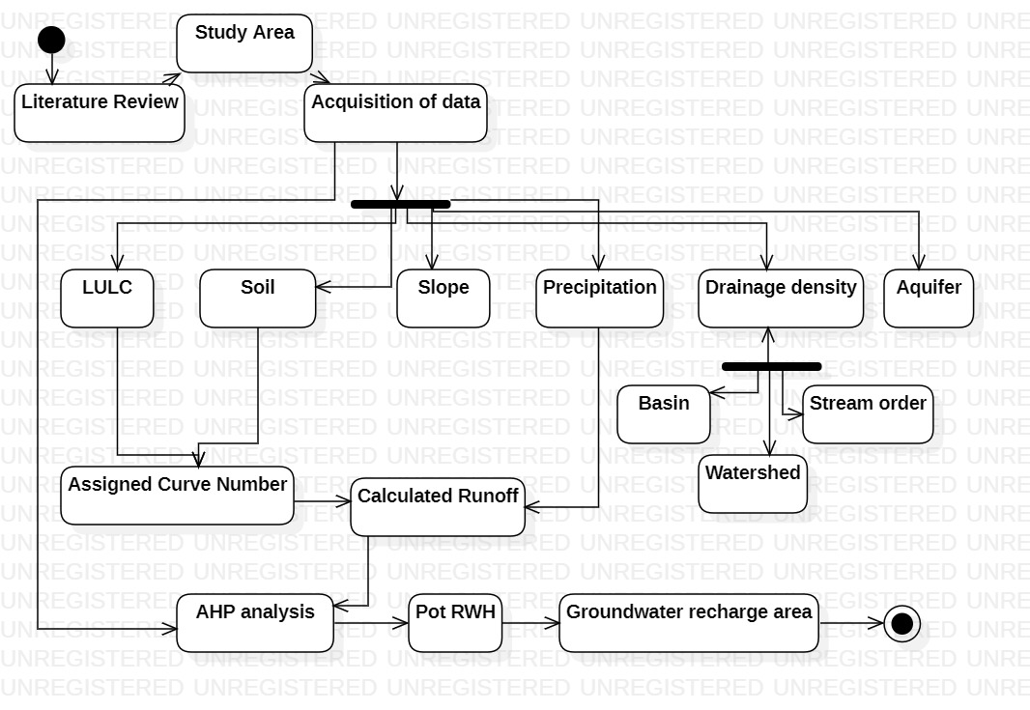
ACTIVITY DIAGRAM

Slide 17
AHP MATRIX
Pairwise Comparison Matrix
Class | Geology | LULC | Drainage Density | Soil | Runoff | Slope
Geology | 1 | 4 | 5 | 7 | 8 | 9
LULC | 0.25 | 1 | 4 | 5 | 6 | 7
Drainage Density | 0.2 | 0.25 | 1 | 5 | 7 | 8
Soil | 0.142857143 | 0.2 | 0.2 | 1 | 6 | 7
Runoff | 0.125 | 0.166666667 | 0.142857143 | 0.166666667 | 1 | 4
Slope | 0.111111111 | 0.142857143 | 0.125 | 0.142857143 | 0.25 | 1
Total | 1.828968254 | 5.75952381 | 10.46785714 | 18.30952381 | 28.25 | 36
Priority Vector
0.43906857
0.228725407
0.165229988
0.098898243
0.044423569
0.023654223
Lamda max | 7.244074675
 | 0.244074675
CI | 0.040679113
CR | 0.03081751

Slide 18
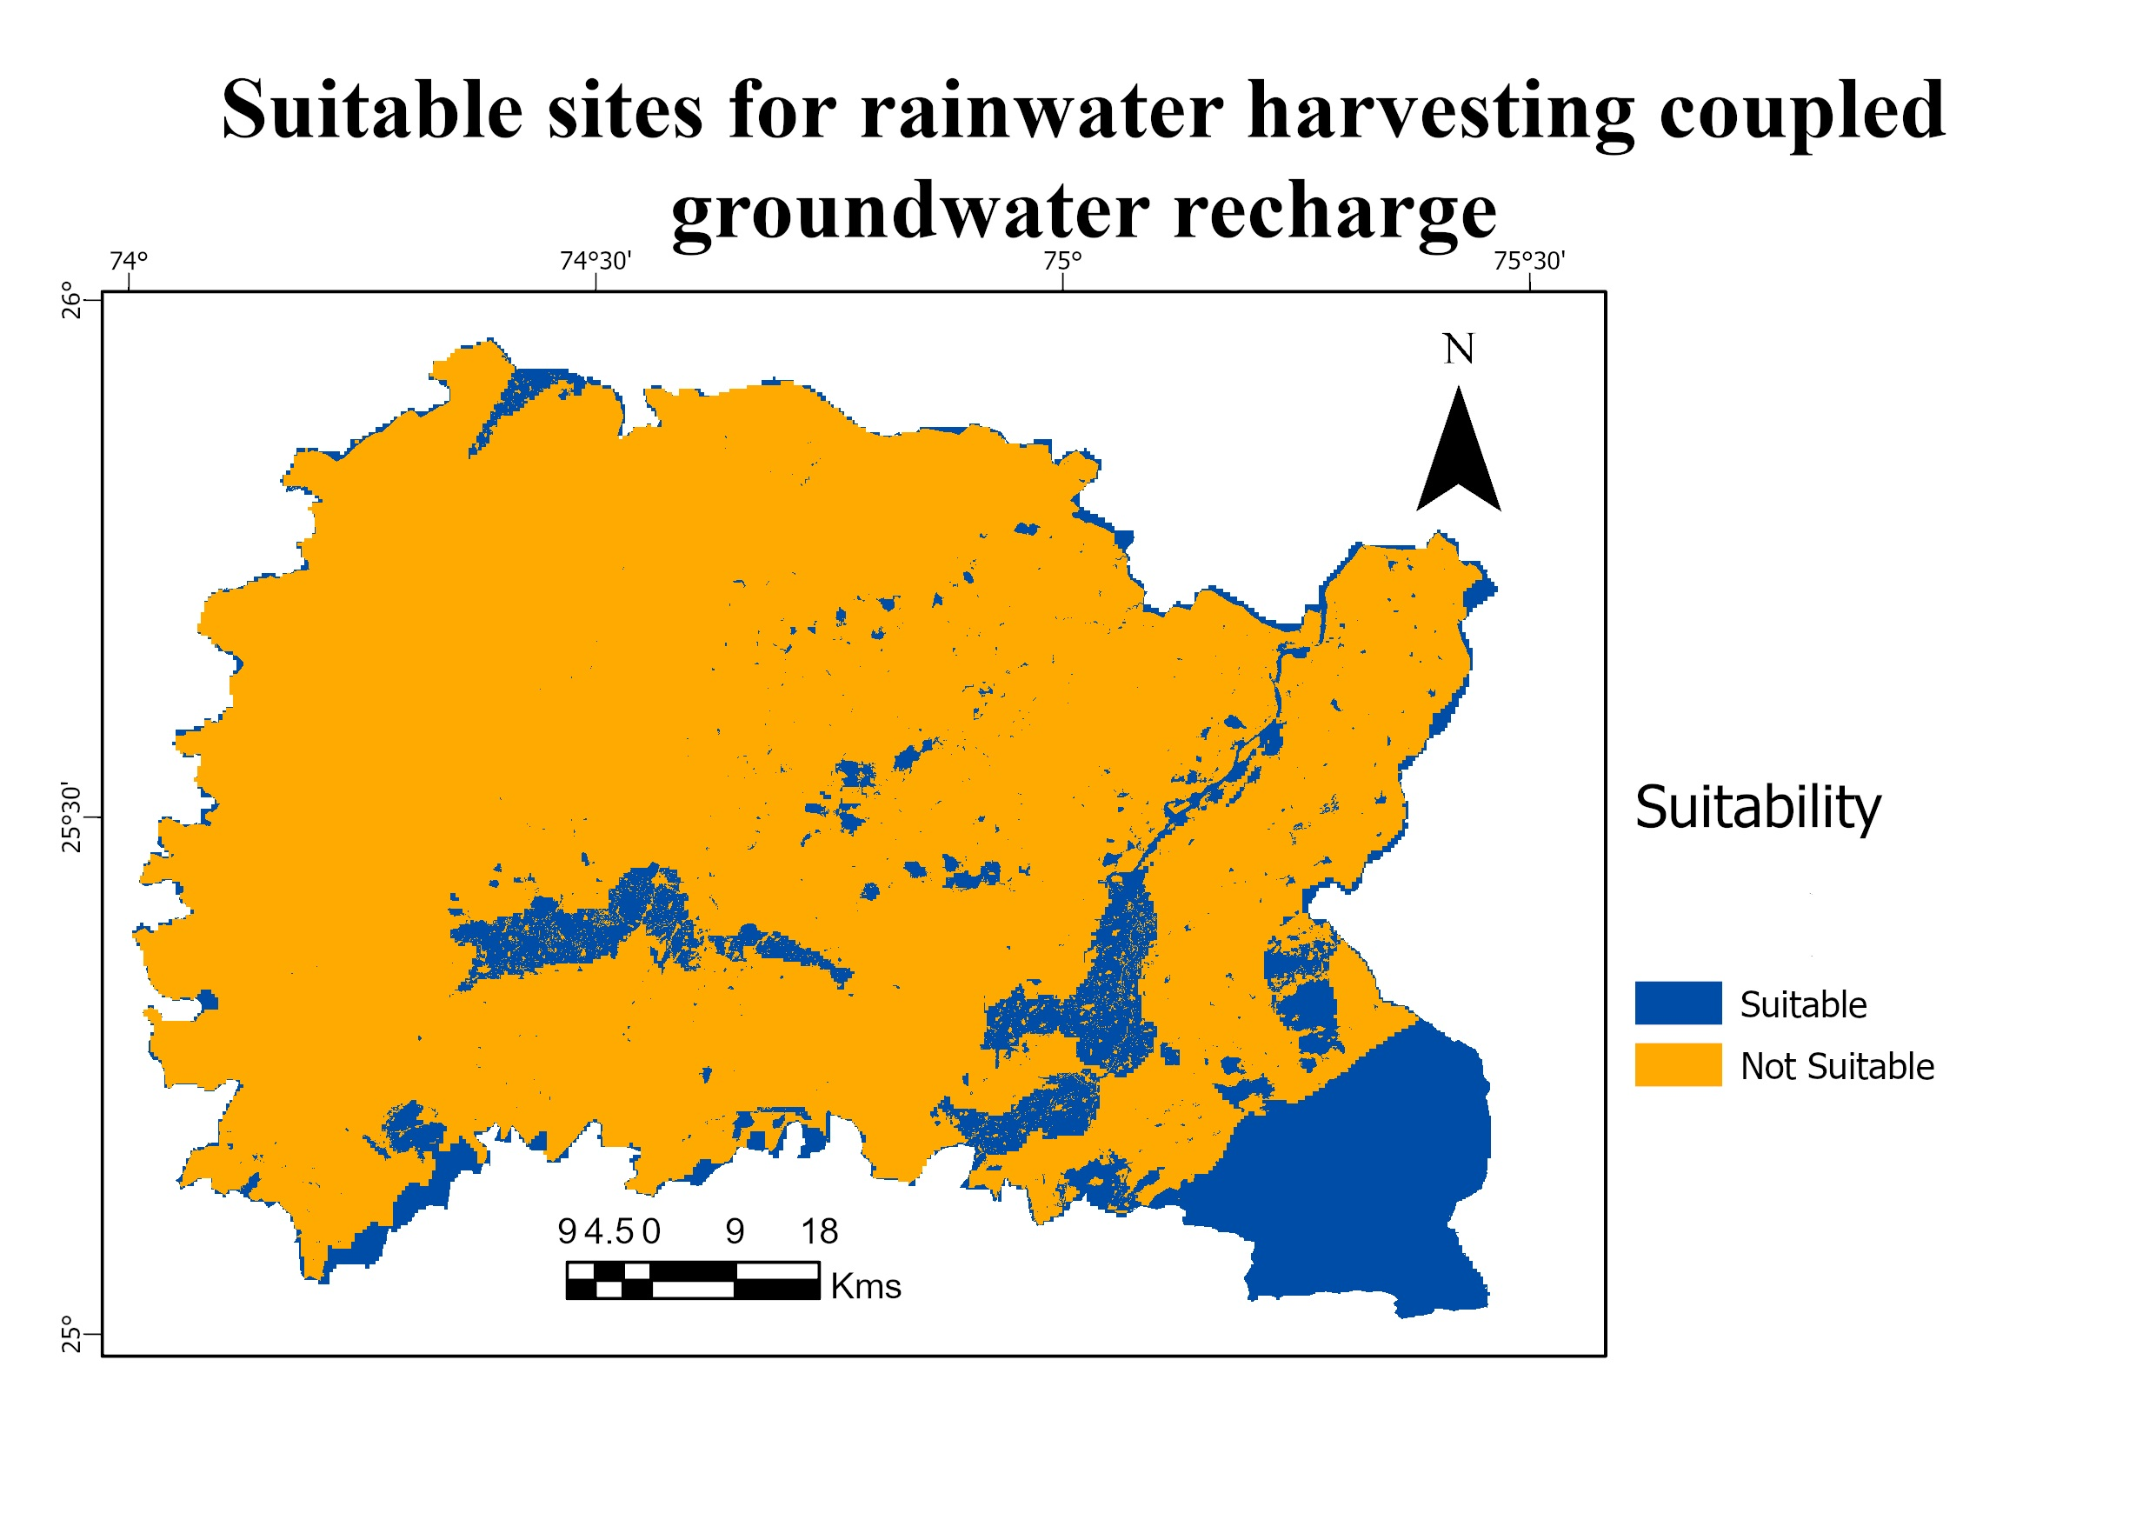

Slide 19
RESULTS
The final output of our analysis gives us sites in the study area which are most suitable for rainwater harvesting coupled with groundwater recharge.
The factors affecting the potential for groundwater recharge in this arid region are given below in decreasing order of importance, Geology of the area (aquifer characteristics), Land use the land cover of the area as it controls the amount of infiltration and recharge potential, Drainage density which serves are the next stage of surface runoff and a natural recharging formation.
Soil characteristics such as porosity, permeability, and grain size control the rate of percolation, Runoff potential also controls the duration of stagnation of water for infiltration,
The slope is an additional parameter that controls the runoff and feasibility of constructing rainwater harvesting structures.
Total groundwater recharge area = 16.58 sq. km in those suitable sites.

Slide 20
CONCLUSION
In conclusion, this study provides a solution to the Bhilwara district in the Rajasthan water crisis. The groundwater recharge, not only fulfills the demand of the population but additionally suppresses the concentration of contaminants in the groundwater which may further cause fatal health ailments to the public. Water is the most important resource in this scenario of climate change and its management is essential to the survival of people and restoration of the environment.
GITHUB REPOSITORY
https://github.com/SamhithaBollepally/Workflow.git

Slide 21
REFERENCES
Abdulla Umar Naseef, T., & Thomas, R. (2016). Identification of Suitable Sites for Water Harvesting Structures in Kecheri River Basin. Procedia Technology, 24, 7–14. https://doi.org/10.1016/j.protcy.2016.05.003
Al-Abadi, A. M., Shahid, S., Ghalib, H. B., & Handhal, A. M. (2017). A GIS-Based Integrated Fuzzy Logic and Analytic Hierarchy Process Model for Assessing Water-Harvesting Zones in Northeastern Maysan Governorate, Iraq. Arabian Journal for Science and Engineering, 42(6), 2487–2499. https://doi.org/10.1007/s13369-017-2487-1
Jasrotia, A. S., Majhi, A., & Singh, S. (2009). Water balance approach for rainwater harvesting using remote sensing and GIS techniques, Jammu Himalaya, India. Water Resources Management, 23(14), 3035–3055. https://doi.org/10.1007/s11269-009-9422-5
JOTHIPRAKASH, V., & SATHE, M. V. (2009). Evaluation of Rainwater Harvesting Methods and Structures Using Analytical Hierarchy Process for a Large Scale Industrial Area. Journal of Water Resource and Protection, 01(06), 427–438. https://doi.org/10.4236/jwarp.2009.16052
Kadam, A. K., Kale, S. S., Pande, N. N., Pawar, N. J., & Sankhua, R. N. (2012). Identifying Potential Rainwater Harvesting Sites of a Semi-arid, Basaltic Region of Western India, Using SCS-CN Method. Water Resources Management, 26(9), 2537–2554. https://doi.org/10.1007/s11269-012-0031-3
Krois, J., & Schulte, A. (2014). GIS-based multi-criteria evaluation to identify potential sites for soil and water conservation techniques in the Ronquillo watershed, northern Peru. Applied Geography, 51, 131–142. https://doi.org/10.1016/J.APGEOG.2014.04.006
Mahmoud, S. H., & Alazba, A. A. (2015). The potential of in situ rainwater harvesting in arid regions: developing a methodology to identify suitable areas using GIS-based decision support system. Arabian Journal of Geosciences, 8(7), 5167–5179. https://doi.org/10.1007/s12517-014-1535-3

